Slide 1
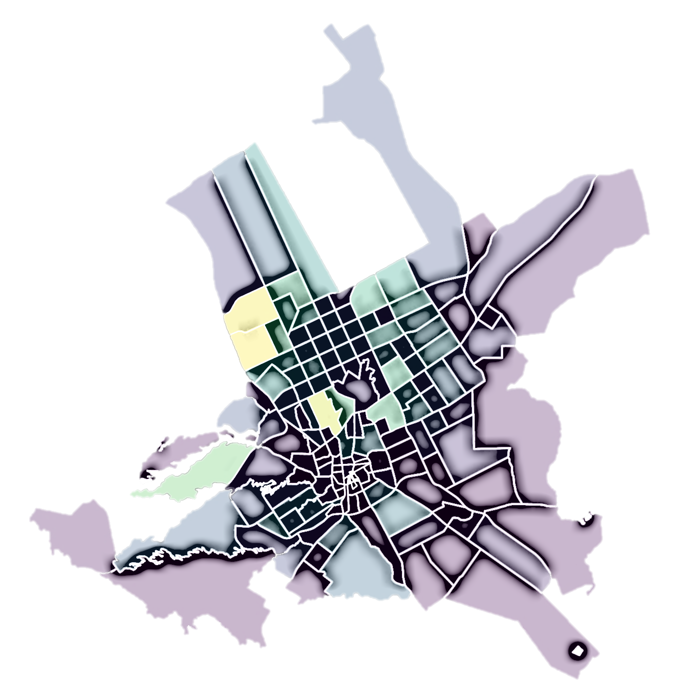

EDA for Restaurants and Cafes in Riyadh
By Rahaf Yousef Almayouf
18 November, 2021

Slide 2
Outlines
Introduction
Objectives of the project.
Design
Questions that the data will answer.
Data
Overview and description of the dataset.
Algorithm
Answers and conclusions.
Tools
Libraries and programs that were used.

Slide 3
Introduction
With the number of places in Riyadh increasing, We wonder what attracts people ?
This project aims to:
Explore the good areas places.
Find out what people like and prefer.

Slide 4
Design

Slide 5



Design
Is there a relationship between prices and ratings ?
Does everyone who likes the place take a photo of it ?
What are the most common areas where cafes and restaurants are located ?
What is the ratio of restaurants, cafes and shops ?
What is the most liked type of restaurant?

Slide 6
Data

Slide 7
Data
Overview
The dataset includes information about most restaurants, cafes and shops in Riyadh region.
Description
Name (str) , Categories (str), address (str), Latitude (float), Longitude (float), Price (str), likes (float), photos (int), tips (int), rating (float), ratingSignals (int).
Size
20,000 rows and 11 columns → 16,460 rows and 19 columns.
Source
Kaggle

Slide 8
Algorithms

Slide 9
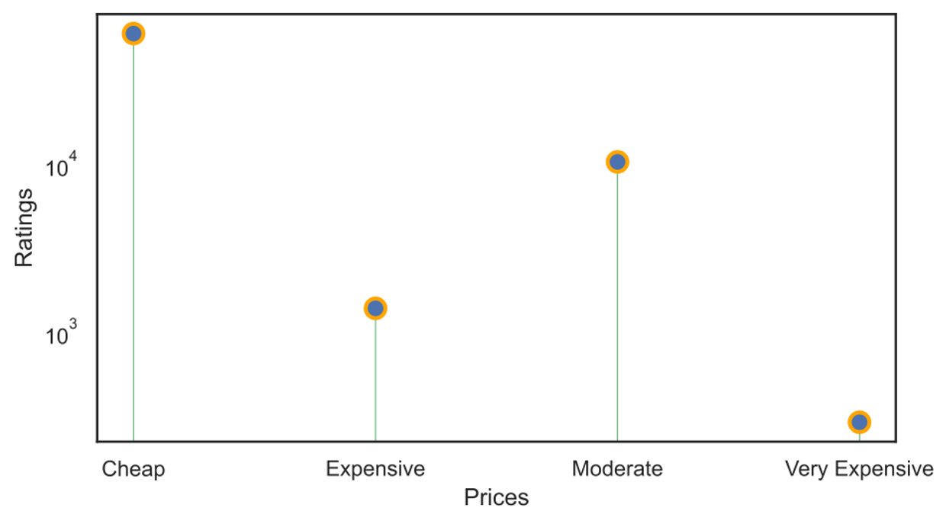
Algorithms
Is there a relationship between prices and ratings ?
The higher of the price, the lower of the rating.
Negative correlation.

Slide 10
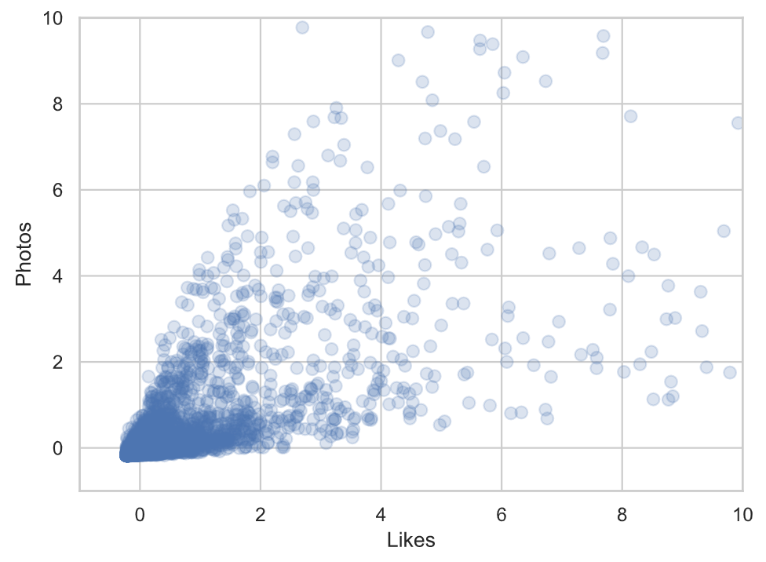
Algorithms
Does everyone who likes the place take a photo of it ?
The higher of the likes, the higher of the photos.
Positive correlation.

Slide 11
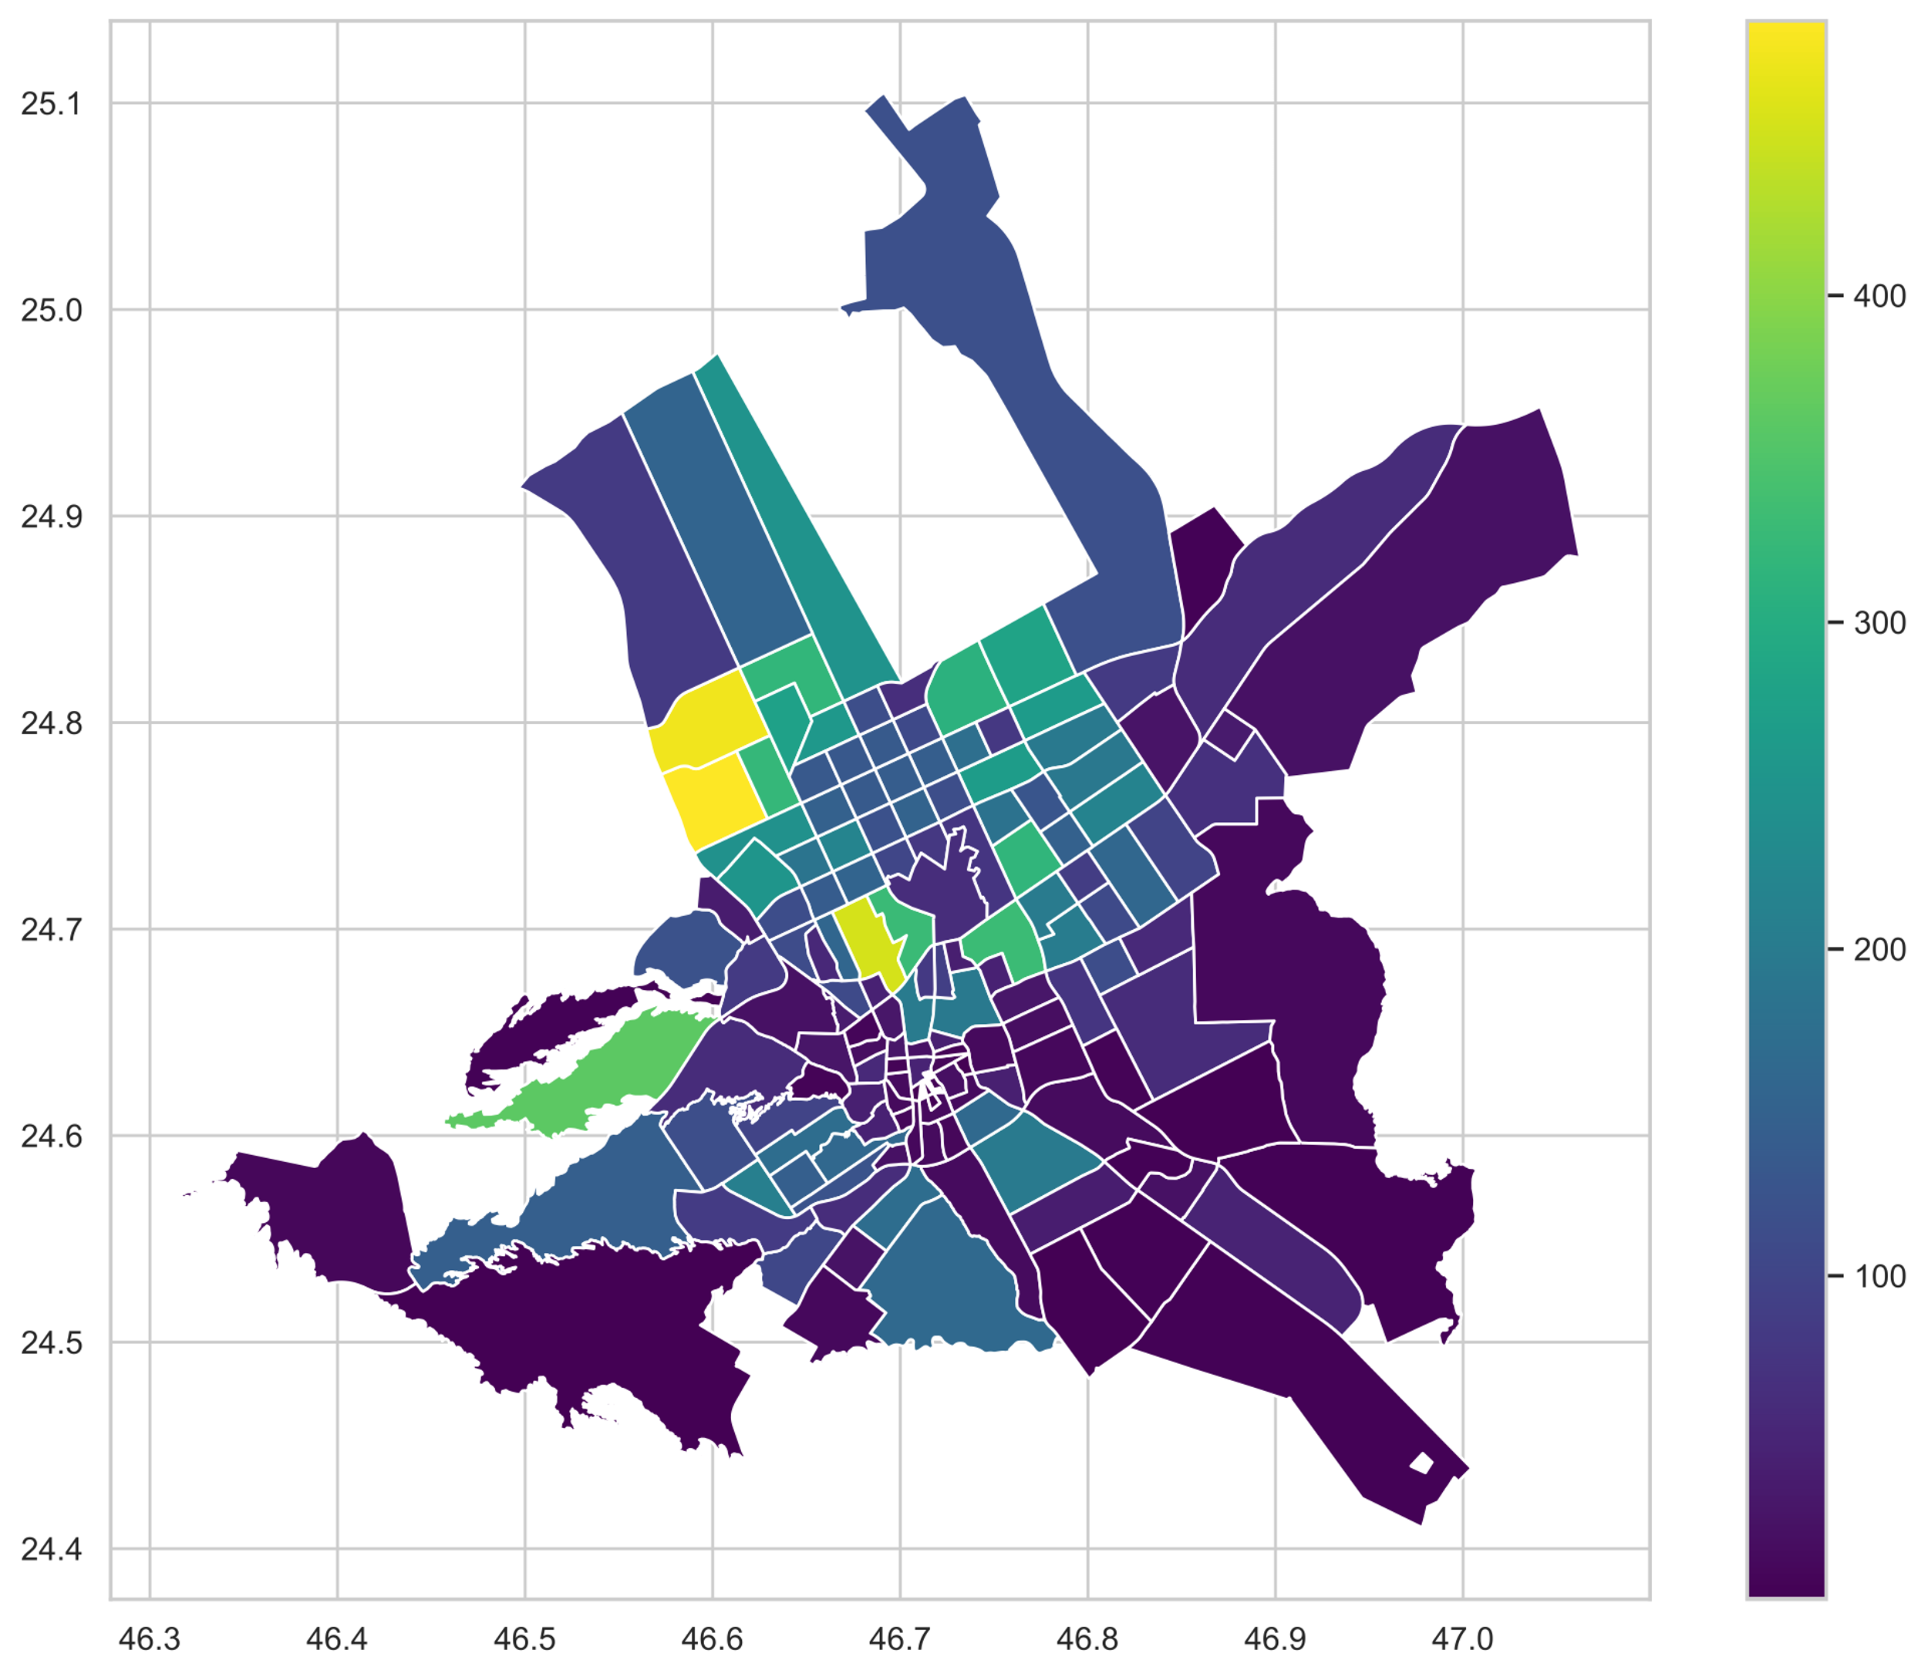
Algorithms
What are the most common areas where cafes and restaurants are located ?
The brighter of the color, the more places there are in the area.

Slide 12
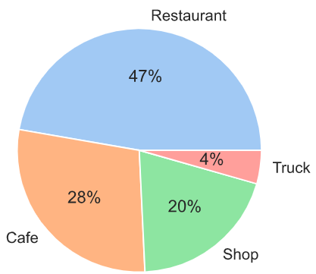
Algorithms
What is the ratio of restaurants, cafes and shops ?
The ratio of restaurants more than cafes, and cafes more than shops, and shops more than food trucks.

Slide 13
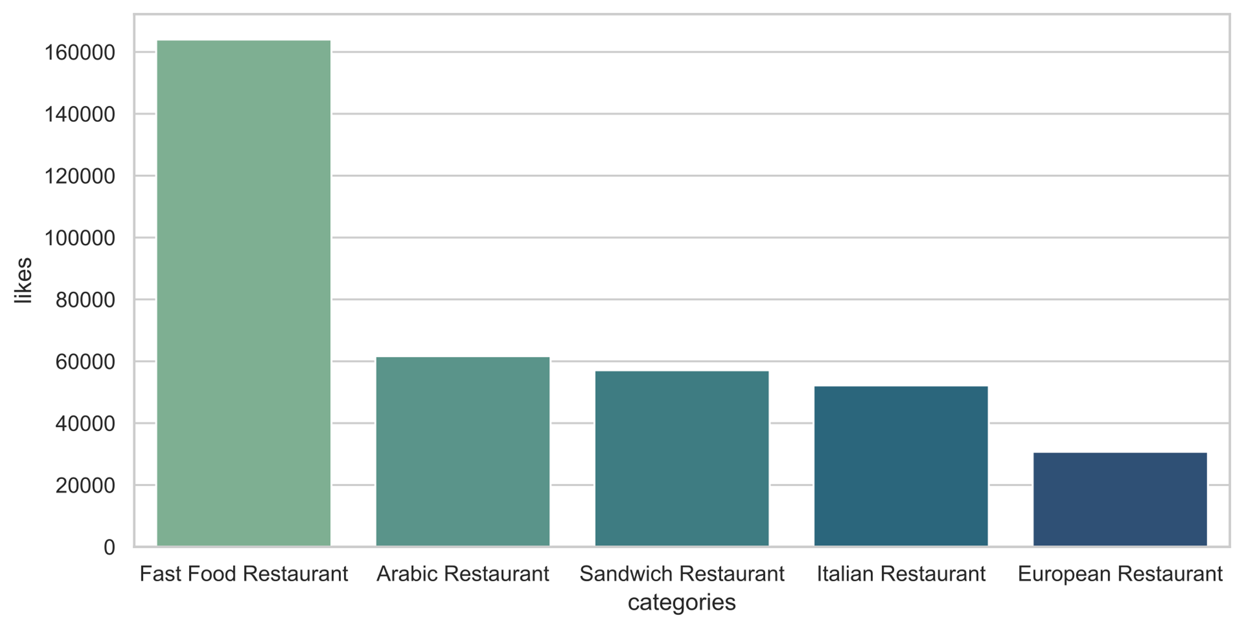
Algorithms
What is the most liked type of restaurant ?
Top 5 types of restaurants liked by people.

Slide 14
Conclusion
People prefer places with low price.
Price
People share photos of places they like.
Likes
Most places in the central region.
Area
Most people prefer fast food.
Types

Slide 15
Tools

Slide 16
Tools
Numpy
Seaborn
Pandas
Matplotlib
Geopandas & Geopy

Slide 17
Thank you for listening

